Slide 1
A PROPOSED CONTROLLER-BASED FREE-SPACE OPTICAL NETWORK ARCHITECTURE WITH LAGRANGE POINT RELAYS FOR EARTH-MARS COMMUNICATION
Nicholas D. Zayfman

Slide 2
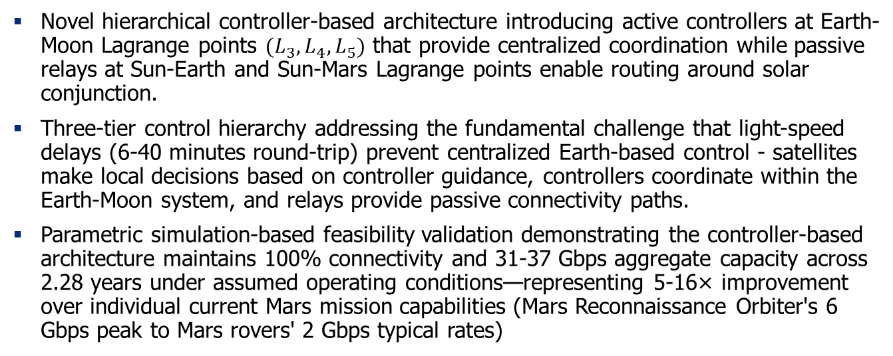
Contributions
Novel hierarchical controller-based architecture introducing active controllers at Earth-Moon Lagrange points ${(L}_{3}, L_{4}, L_{5})$ that provide centralized coordination while passive relays at Sun-Earth and Sun-Mars Lagrange points enable routing around solar conjunction.
Three-tier control hierarchy addressing the fundamental challenge that light-speed delays (6-40 minutes round-trip) prevent centralized Earth-based control - satellites make local decisions based on controller guidance, controllers coordinate within the Earth-Moon system, and relays provide passive connectivity paths.
Parametric simulation-based feasibility validation demonstrating the controller-based architecture maintains 100% connectivity and 31-37 Gbps aggregate capacity across 2.28 years under assumed operating conditions—representing 5-16× improvement over individual current Mars mission capabilities (Mars Reconnaissance Orbiter's 6 Gbps peak to Mars rovers' 2 Gbps typical rates)

Slide 3
Current Challenges
Modern instruments can collect far more data than can be transmitted.
Forcing scientists to prioritize which data to transmit vs. discard with potential discoveries remaining unanalyzed in memory and eventually deleted.
Solar Conjunction occurs every 26 months when Mars passes behind the Sun and causes complete communication loss for up to 3 weeks.
Human Mars missions demand continuous connectivity for telemetry, mission control, and psychological support.
Increase in number of missions to Mars, future space missions will rely on networks of spacecraft that will work together with each additional node multiply the data generation rate while competing for the same limited bandwidth.

Slide 4
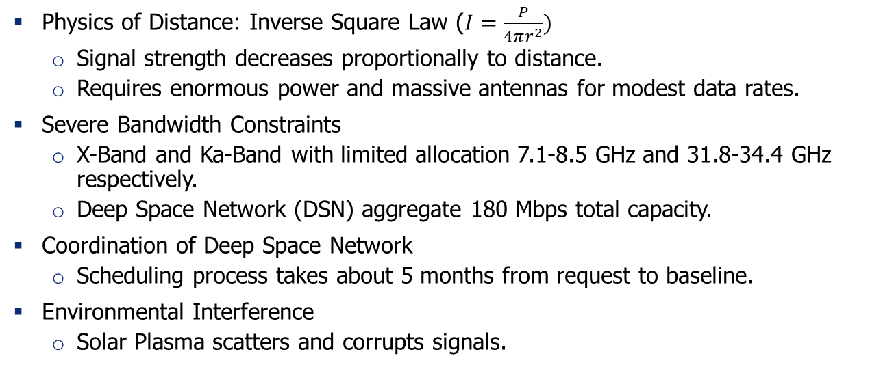
Limitations of Current RF Systems
Physics of Distance: Inverse Square Law ($I=\frac{P}{4πr^{2}})$
Signal strength decreases proportionally to distance.
Requires enormous power and massive antennas for modest data rates.
Severe Bandwidth Constraints
X-Band and Ka-Band with limited allocation 7.1-8.5 GHz and 31.8-34.4 GHz respectively.
Deep Space Network (DSN) aggregate 180 Mbps total capacity.
Coordination of Deep Space Network
Scheduling process takes about 5 months from request to baseline.
Environmental Interference
Solar Plasma scatters and corrupts signals.

Slide 5
Research Objective and Methodology
Design and simulate a hierarchical FSO network architecture for Earth-Mars communications.
Maintain continuous connectivity throughout entire Mars synodic cycle.
Achieve substantial bandwidth improvements.
Enable autonomous network coordination.
Establish scalable infrastructure.
Demonstrate feasibility.
Combined theoretical analysis with parametric simulation (Not hardware validation) in order to demonstrate architectural feasibility.
Engineering estimates for key parameters requiring future validation

Slide 6
Research Scope
Spatial Scope
Earth-Mars corridor communication. No Earth/Mars ground station to satellite communication, in other words, strict satellite to satellite communication.
Lagrange Points for the Earth-Moon, Sun-Earth, and Sun-Mars Lagrange points.
Satellite to Satellite FSO Links.
Operational Scope
2.28-year parametric simulation to represent one complete Mars synodic cycle
Architectural feasibility demonstration with 8 Earth Satellites, 4 Mars satellites, 3 controller satellites, and 8 relay satellites.

Slide 7
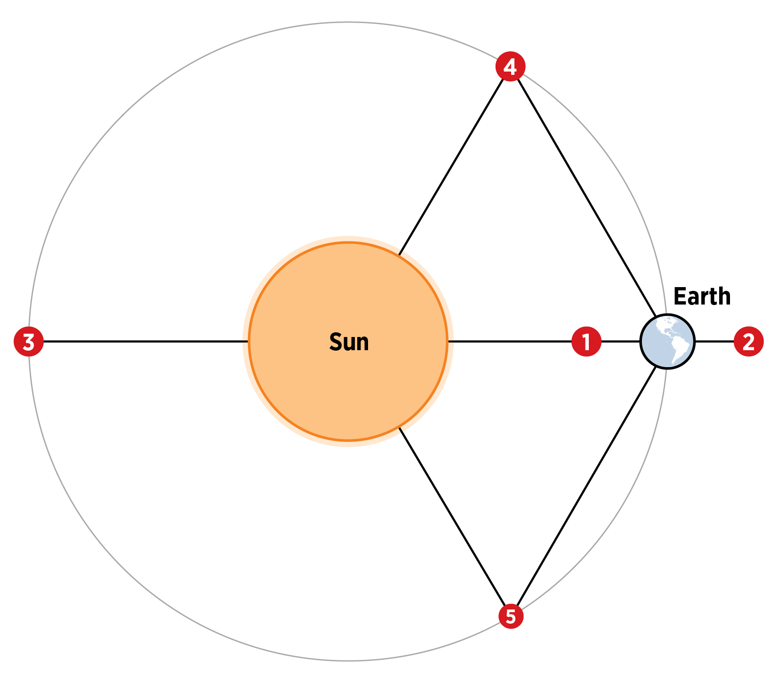
Lagrange Points
Gravitationally stable positions where spacecraft can maintain fixed positions relative to two large celestial bodies.
There exists Lagrange Points in the following three systems: Earth-Moon, Sun-Earth, and Sun-Mars.
Natural positioning eliminates need for complex orbital mechanics while providing optimal coverage geometry.

Slide 8
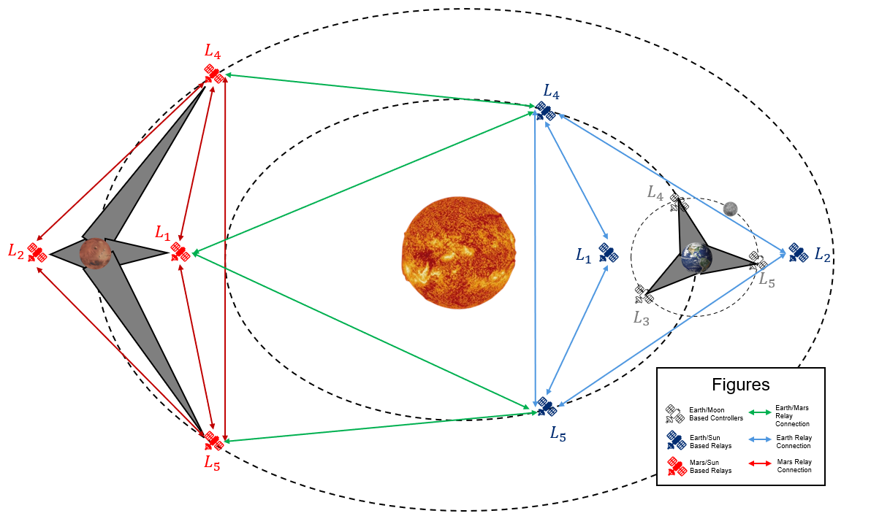
Strategic Relay/Controller Positioning

Slide 9
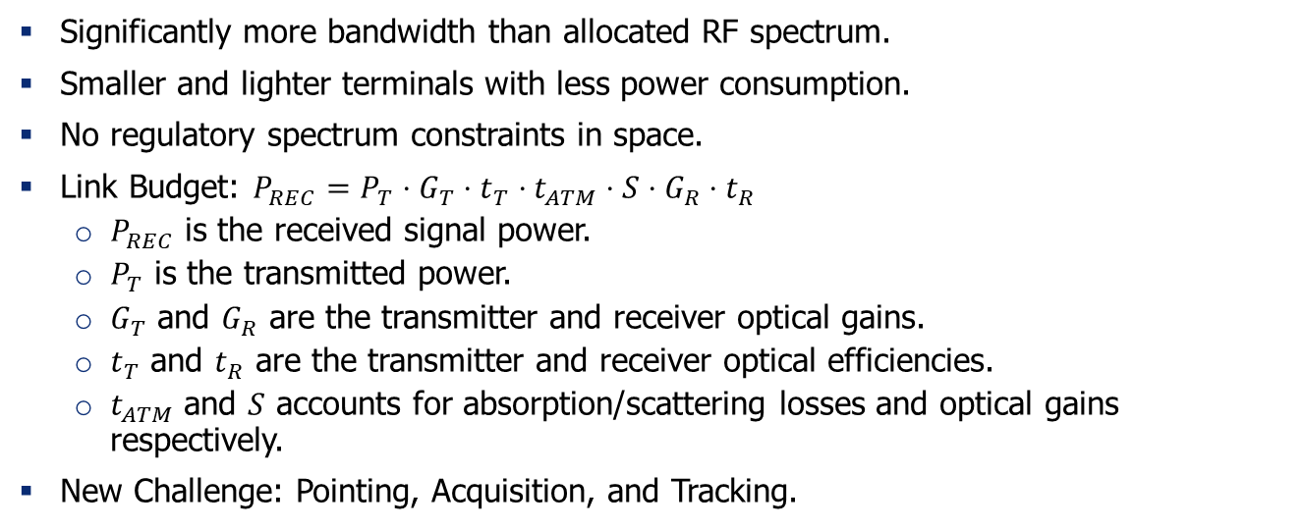
Free Space Optical (FSO) Communication
Significantly more bandwidth than allocated RF spectrum.
Smaller and lighter terminals with less power consumption.
No regulatory spectrum constraints in space.
Link Budget: $P_{REC}=P_{T}⋅G_{T}⋅t_{T}⋅t_{ATM}⋅S⋅G_{R}⋅t_{R}$
$P_{REC}$ is the received signal power.
$P_{T}$ is the transmitted power.
$G_{T}$ and $G_{R}$ are the transmitter and receiver optical gains.
$t_{T}$ and $t_{R}$ are the transmitter and receiver optical efficiencies.
$t_{ATM}$ and $S$ accounts for absorption/scattering losses and optical gains respectively.
New Challenge: Pointing, Acquisition, and Tracking.

Slide 10
Controller Concept in Networks
Controllers maintain global network state and compute optimal routing decisions, while individual nodes execute locally based on controller guidance -- separating the "brain" (planning) from the "muscles" (data transmission).
Network behavior can be modified through software rather than reconfiguring individual devices -- enabling rapid policy changes, traffic engineering, and custom routing protocols without hardware changes
Controllers can actively balance traffic across multiple paths based on real-time congestion, link utilization, and QoS requirements -- preventing bottlenecks and maximizing aggregate throughput.
Controllers detect link/node failures quickly and can precompute backup paths or instantly reroute traffic, minimizing packet loss and maintaining higher effective throughput during network changes

Slide 11
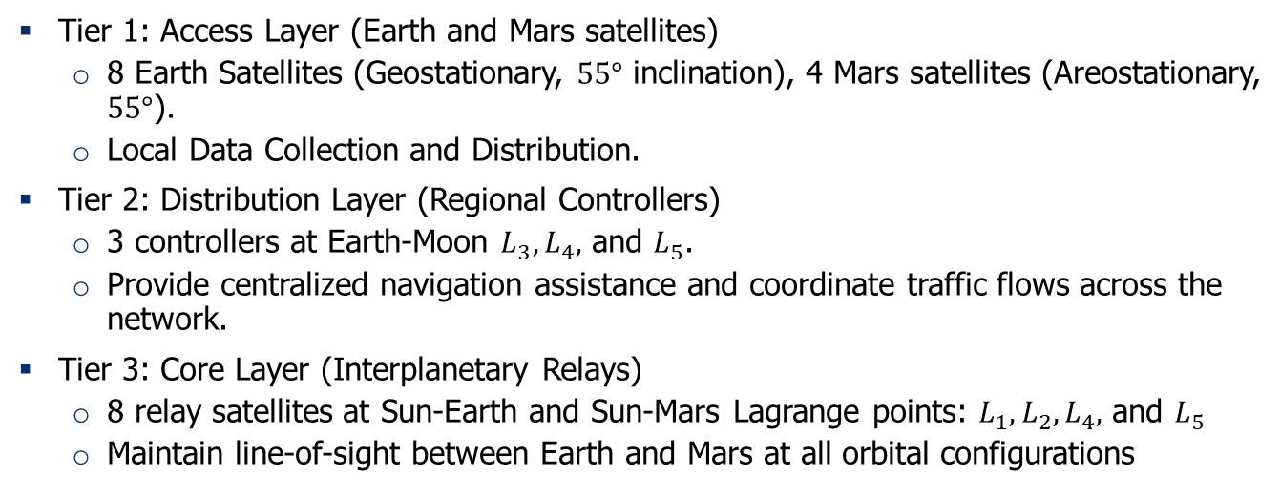
Hierarchical Coordination Architecture
Tier 1: Access Layer (Earth and Mars satellites)
8 Earth Satellites (Geostationary, $55°$ inclination), 4 Mars satellites (Areostationary, $55°$).
Local Data Collection and Distribution.
Tier 2: Distribution Layer (Regional Controllers)
3 controllers at Earth-Moon $L_{3}, L_{4},$ and $L_{5}$.
Provide centralized navigation assistance and coordinate traffic flows across the network.
Tier 3: Core Layer (Interplanetary Relays)
8 relay satellites at Sun-Earth and Sun-Mars Lagrange points: ${L_{1},L}_{2}, L_{4},$ and $L_{5}$
Maintain line-of-sight between Earth and Mars at all orbital configurations

Slide 12
Why Controllers are Essential?
01
FSO Technical Complexity
02
FSO Hidden Node Problem
03
Light-Speed Delay Constraint
Satellites cannot simultaneously maintain active optical links, compute precise ephemeris predictions, and optimize routing decisions across a changing topology.
Controllers offload computational burden and reduce overall satellite complexity and power consumptions.
Satellites cannot detect when others are transmitting to the same relay and if two beams hit the same receiver then all data would be corrupted.
Controllers have centralized view of the entire network topology and can implement time-division scheduling to prevent collisions.
Vast distance prevents timely response from Earth to dynamic link failures, geometry changes, and network optimization.
Controllers are closer and can respond faster and enable near-real-time coordination while Earth-based control cannot.

Slide 13
Why Controllers are Essential?
04
Network Memory during Disruption
05
Operational & Economic Advantages
Failures isolate clusters of satellites, when connectivity is restored, how do fragments “find” each other? Purely distributed systems lose global state.
Controllers maintain topology state through disruptions, remember which satellites exist and their last known positions, and enable rapid connectivity restoration when clusters reunite.
Complex satellites are expensive and failure-prone. Failed acquisition attempts waste power. Upgrading algorithms requires modifying entire constellations.
Controllers simplify satellite designs, reduce power consumptions from unsuccessful acquisitions, and centralize complexity in a few platforms.

Slide 14
Simulation Framework
Core Libraries: SpacePy (Space Physics), NetworkX (Graph Analysis), Astropy (NASA ephemeris), NumPy/SciPy (Numerical methods)
Snapshot-based network topology updates: 15 minute update intervals over 2.28 years (80,000 time steps)
Integrated models: NASA JPL DE440 ephemeris for planetary positions; Majumdar FSO link budget; Lagrange point calculations for Earth-Moon, Sun-Earth, Sun-Mars systems; line-of-sight occlusion.
Built-in validation framework: Solar conjunction scenarios, link failure recover, traffic overload testing
Complete code available: github.com/nickyduesxd/Masters_Thesis

Slide 15
Orbital Mechanics Implementation
NASA JPL DE440 ephemeris integration for accurate planetary motion.
Precise Lagrange point calculations using analytical solutions.
Hybrid orbital propagation approach balances fidelity with stability
Comprehensive perturbation modeling for satellites:
J₂ oblateness effects: Earth's gravitational harmonics (J₂ = 1.08263 × 10⁻³)
Solar radiation pressure: Area-to-mass ratio = 0.0133 m²/kg
Third-body gravitational effects: Sun and Moon perturbations
Relativistic corrections: Post-Newtonian effects for high-precision orbits
Numerical safeguards prevent unrealistic perturbation magnitudes

Slide 16
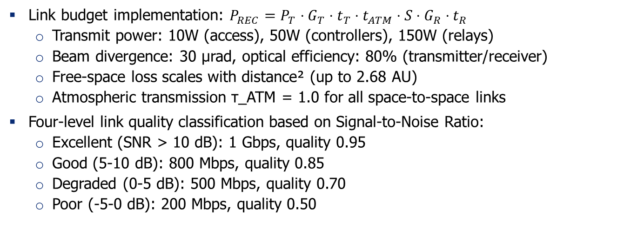
FSO Link Modeling
Link budget implementation: $P_{REC}=P_{T}⋅G_{T}⋅t_{T}⋅t_{ATM}⋅S⋅G_{R}⋅t_{R}$
Transmit power: 10W (access), 50W (controllers), 150W (relays)
Beam divergence: 30 μrad, optical efficiency: 80% (transmitter/receiver)
Free-space loss scales with distance² (up to 2.68 AU)
Atmospheric transmission τ_ATM = 1.0 for all space-to-space links
Four-level link quality classification based on Signal-to-Noise Ratio:
Excellent (SNR > 10 dB): 1 Gbps, quality 0.95
Good (5-10 dB): 800 Mbps, quality 0.85
Degraded (0-5 dB): 500 Mbps, quality 0.70
Poor (-5-0 dB): 200 Mbps, quality 0.50

Slide 17
FSO System Parameters
Parameter | Value | Units | Notes
Wavelength | 1550 | nm | Standard telecom wavelength
Beam Divergence | 30 | µrad | Engineering target
Pointing Accuracy (Baseline) | 10.0 | µrad | Without controller assistance
Baseline Data Rate | 1.0 | Gbps | Per link baseline
Optical Efficiency (Transmitter) | 80% | - | Optimistic for space environment
Optical Efficiency (Receiver) | 80% | - | Optimistic for space environment
Solar Exclusion Radius | 5.0 × Solar Radius | km | Conservative estimate
Link Quality Variation | 5% | standard deviation | Engineering estimate

Slide 18
Navigation-Assisted Acquisition
Controllers maintain precise ephemeris data, provide pre-computed pointing vectors, and reduce acquisition search space.
Parameter | Baseline (No Controller) | With Controller | Improvement
Acquisition Time | 30 minutes (1800s) | 15 minutes (900s) | 50% reduction
Acquisition Success Rate | 75% | 80% | +5%
Pointing Error | 10.0 µrad | 5.0 µrad | 50% reduction
SNR Enhancement | Baseline | +2 dB | +2 dB improvement
Processing Delay | 0.1 ms | 0.08 ms | 20% reduction

Slide 19
Controller Coordination System
Navigation assistance updates every 6 minutes provide pre-computed pointing vectors and relay recommendations, enabling 25.4% of connections to benefit from coordination (50% faster acquisition, +2 dB SNR modeled).
Traffic management operates on 3-minute cycles with 5-level QoS priority scheduling (EMERGENCY → CRITICAL → HIGH → NORMAL → LOW)
Dynamic proximity-based regional assignment that places each Earth satellite under the nearest controller at Earth-Moon L₃, L₄, or L₅.
Relay selection algorithm weighs 70% current distance and 30% predicted stability to balance optimal connectivity with minimal handoff frequency, preventing congestion through load-aware recommendations

Slide 20
Key Limitations and Assumptions
Navigation assistance benefits are parametric assumptions requiring hardware validation.
Simplified orbital mechanics for access satellites lacks validation against high-fidelity propagators.
Traffic management framework demonstrates architectural feasibility but incomplete integration.
FSO system parameters represent engineering targets rather than validated performance.
Results demonstrate architectural feasibility under modeled conditions, not deployment-ready performance.

Slide 21
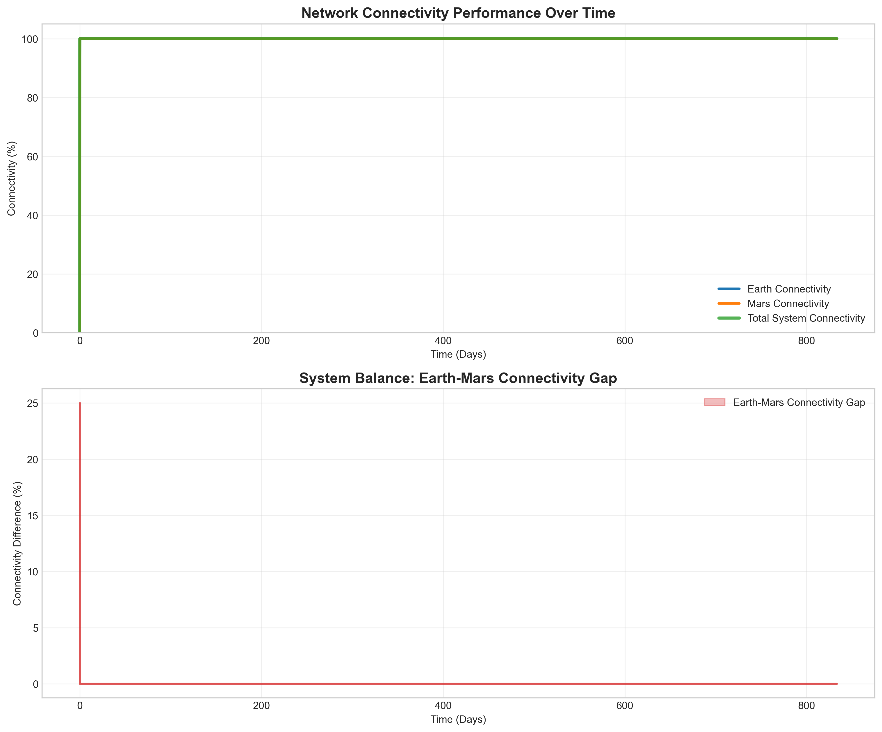
Network Connectivity Performance
100% connectivity maintained throughout 2.28-year simulation period
Earth network: 100% average connectivity after brief initialization period (0-10 days)
Mars network: 100% constant connectivity maintained
Total system connectivity: 100% average throughout operational period
No communication blackouts despite solar conjunction events and varying orbital geometries

Slide 22
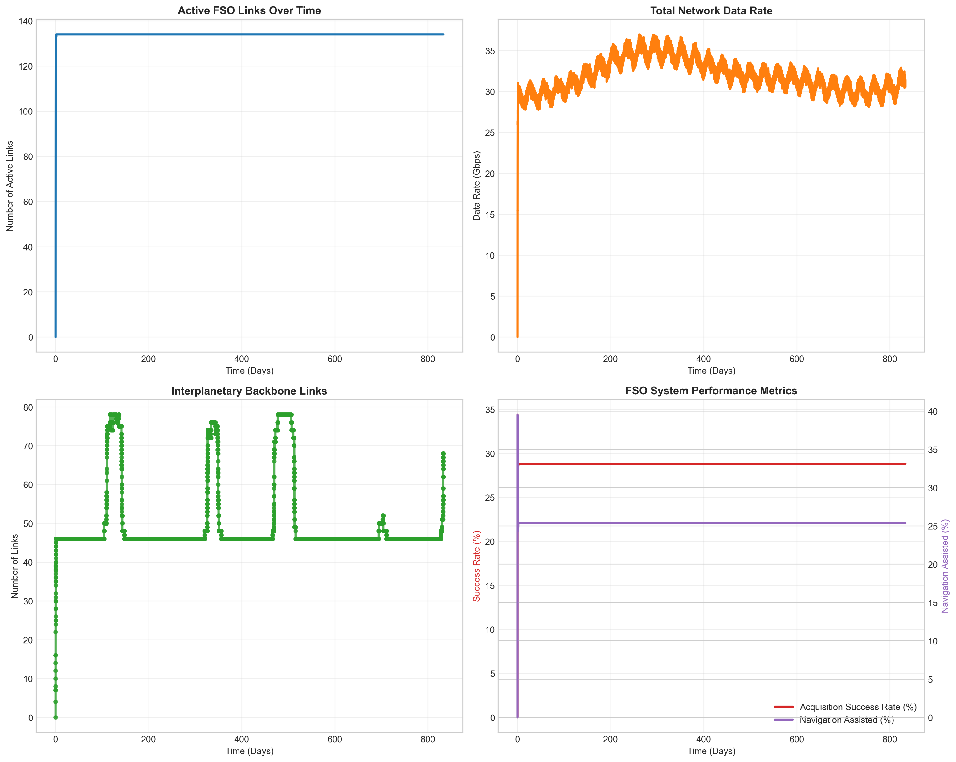
FSO Link Performance
135 simultaneous FSO links sustained with aggregate capacity of 28-37 Gbps.
Interplanetary backbone demonstrates dynamic adaptation to orbital geometry
Baseline operation: 47 active interplanetary FSO links during standard periods
Peak performance: 78 links during favorable planetary alignments (39% increase)

Slide 23
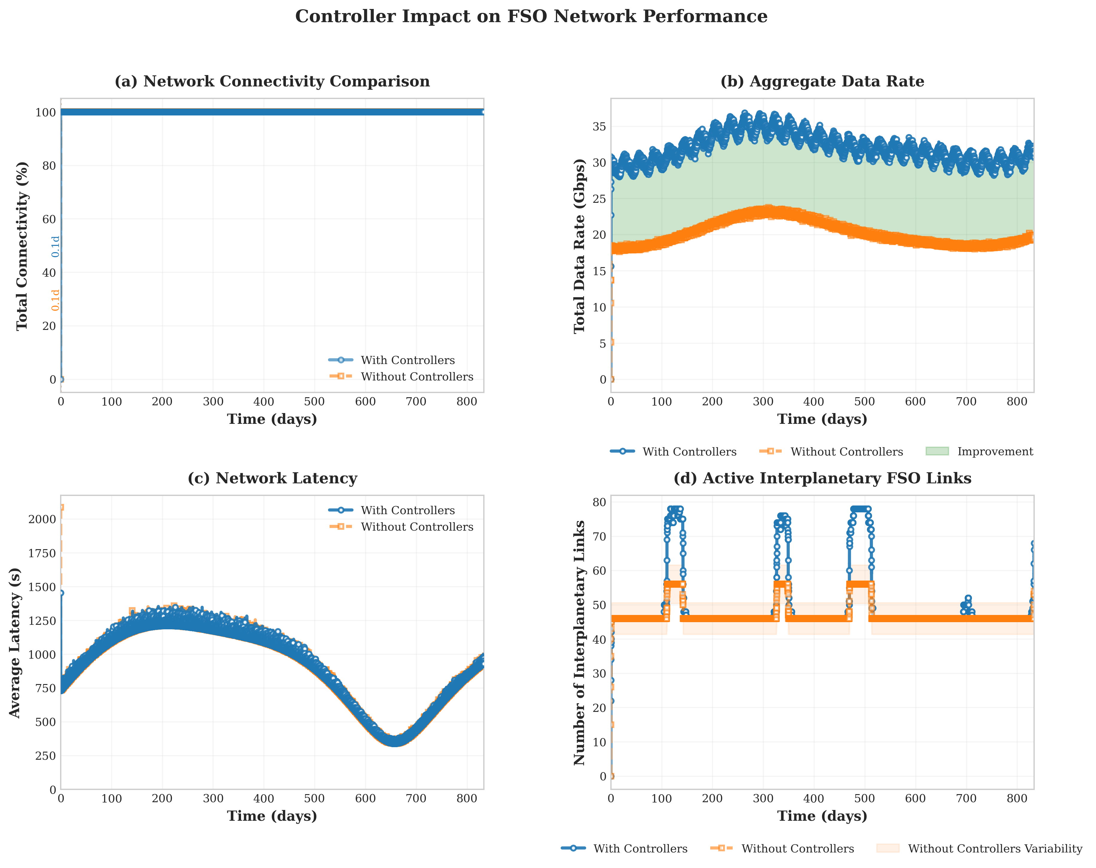
Controller Architecture Impact
55% improvement in network throughput with controller coordination
Average data rate: 31.978 Gbps (with controllers) vs. 20.215 Gbps (without) = 55% increase
Peak capacity: 36.976 Gbps (with controllers) vs. 23.859 Gbps (without) = 55% increase
Controllers enable 39% increase in maximum interplanetary link utilization
With controllers: Peak of 78 active interplanetary FSO links during favorable alignments

Slide 24
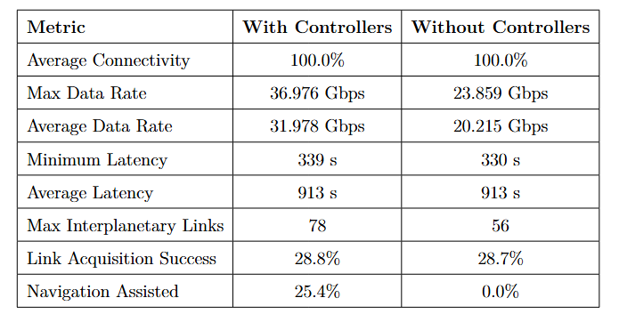
Controller Architecture Impact

Slide 25
Key Advantages
Key architectural advantages of proposed FSO network
Bandwidth scalability: 31-37 Gbps aggregate vs. 2-6 Gbps (RF), 13.7 Gbps (constellation-only)
Conjunction resilience: Zero blackouts vs. 2-3 weeks (DTN/RF), 8-23 days (constellation)
Network topology: Distributed mesh with 135+ links vs. point-to-point or single-trunk
Autonomous coordination: Controllers provide QoS guarantees and predictive management impossible with Earth-based control or purely distributed systems
Deployment pathway: Phased approach (controllers → Earth relays → Mars relays) reduces initial investment while enabling incremental capability growth

Slide 26
Future Work
Hardware-in-the-loop testing: pointing accuracy, acquisition algorithms, link budgets, environmental effects (thermal, vibration, radiation).
Orbital mechanics validation: verify simplified circular orbit propagation against high-fidelity propagators (GMAT/STK) to quantify position errors over multi-year simulation periods
Complete integration of traffic management with link establishment protocols.
Technology demonstrations: CubeSat missions for FSO validation, Earth-Moon L2 relay for regional coordination, Earth-Sun L4/L5 relay proof-of-concept
Machine learning for autonomous network management.
Economic and policy framework development.

Slide 27
Thank You!
Nicholas Zayfman
nzayfma1@jh.edu
(917)-775-1175
https://github.com/nickyduesxd/Masters_Thesis
Notes:
Tip: There’s no need to include WWW or HTTPS in front of your URL.

